Slide 1



CSYE7200 Project​
Real-Time Social Media Keywords Sentiment Analysis System​
Burning Crusade
Team member: Weifan Guo, Xuanli Liu, Zijie Zhou

Slide 2


Corporate brand monitoring(Companies that produce actual products, food, supplies, cars...)​
Hypothetical customers​
News and public opinion analysis(Newspapers, News Media，Advertising...)​
Financial Markets​

Slide 3
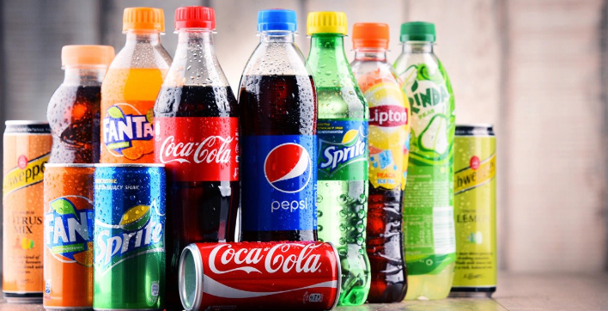
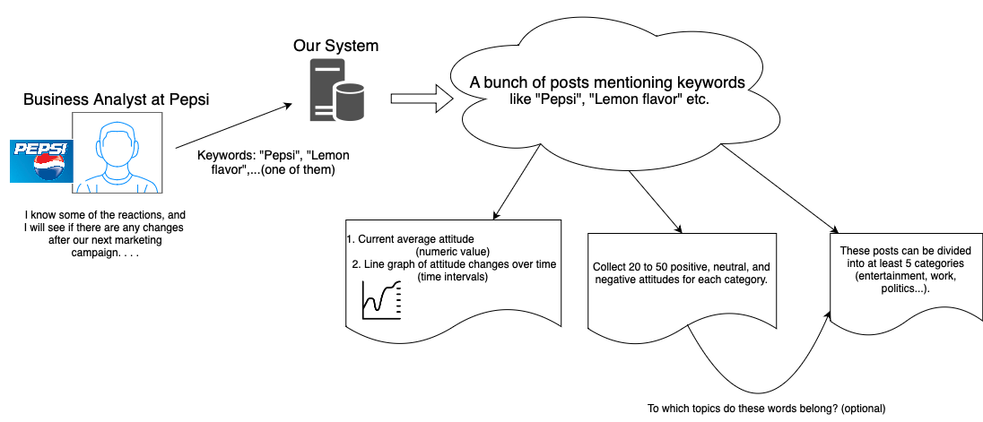
Hypothetical customers​(example)

Slide 4
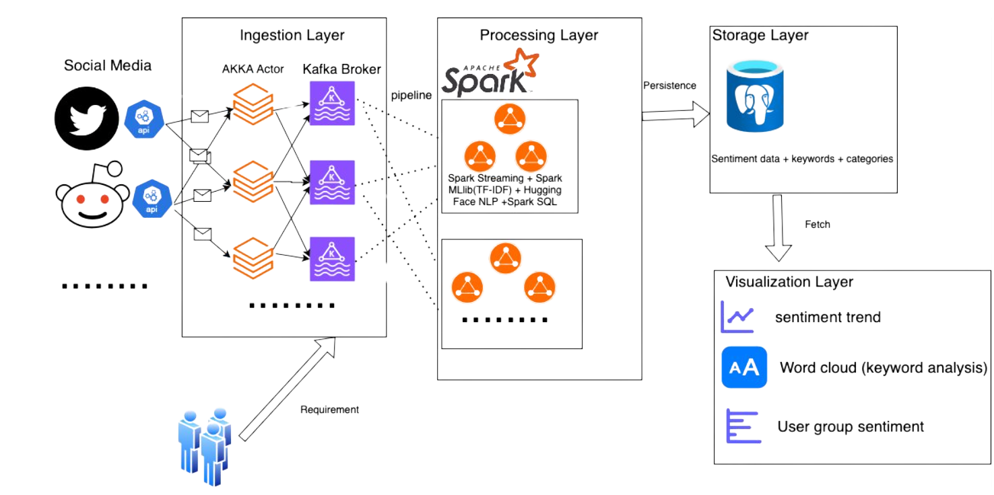
Methodology

Slide 5

Data sources​
Data Sources​
Data Volume & Scalability​
Twitter API / Reddit API: Collect real-time text, timestamps, user info, and geolocation (if available).​
Kafka Streaming: Ingest data into Kafka topics; Spark Streaming (or equivalent) consumes data in real time.​
Ingestion Rate: ~3 new tweets/comments per second
We have insight into the fact that the APIs of those social apps have access # restrictions per day, so we will use multiple accounts to distribute on actors.
Scalability: Designed to handle tens of millions of records through distributed architectures (Spark, PostgreSQL/Elasticsearch).​

Slide 6

About Scala​
✔ Real-Time Data Streaming​
Implement Kafka producers/consumers for continuous data ingestion.​
Process Twitter/Reddit API streams efficiently.​
✔ Big Data Processing (Apache Spark)​
Use Spark Streaming to process large-scale social media data in real-time.​
Perform parallel computing for sentiment analysis.​
✔ Natural Language Processing (NLP)​
Integrate Spark NLP or Hugging Face Transformers to classify sentiment (positive, neutral, negative).​
Optimize model inference speed for real-time insights.​
✔ Concurrent Processing (Akka Actors)​
Enable parallel execution of sentiment analysis requests.​
Ensure system scalability and fault tolerance.​

Slide 7
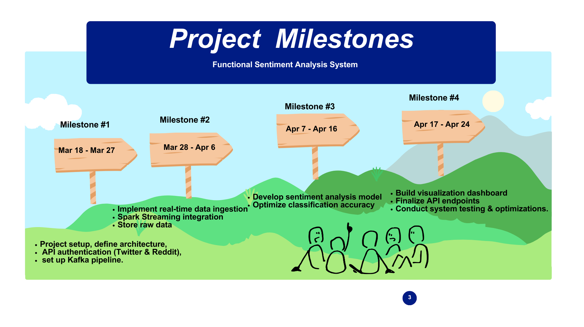

Slide 8

Acceptance criteria
The system can run​ at least 1 day without break
At least ≥ 3 tweets/Reddit comments can be collected per second (to ensure the real-time data flow)​
Support 90% asynchronous API requests without blocking the main thread​
Data deduplication rate ≥ 85% (the same content is not stored repeatedly)​
It can display the visualization interface, numbers, line chart, word cloud mentioned in the above Hypothetical customers​(example) normally. . . .

Slide 9

Goals of the project​
★ Real-Time Data Streaming & Processing → Continuous ingestion and transformation of social media data.​
★ Sentiment Analysis & Keyword Insights → Detect emotion shifts, trending words, and geographic sentiment distribution.​
★ Data Storage & Visualization → Store insights in PostgreSQL/Elasticsearch, visualize trends in Grafana/Kibana.​
★ Scalable & Extensible System → Capable of handling millions of records, adaptable for different industries.​
Deliver a fully functional, high-performance sentiment analysis platform that meets all acceptance criteria and provides real-time insights for businesses and analysts. ​

Slide 10
Thank
You
Presented by Zijie Zhou

